Slide 1
Data science mini-project
On the topic of the covid-19 pandemic [COVID forecasting]
By: Johnathan (U2121835D) and Jabez (U2122613B)
TEAM 10

Slide 2
Table of contents:
01.
Motivation for our project
02.
Cleaning of our data
03.
Exploratory analysis and insights
04.
Machine model used to predict future covid-19 data
05.
Conclusion and what we took away from our project

Slide 3
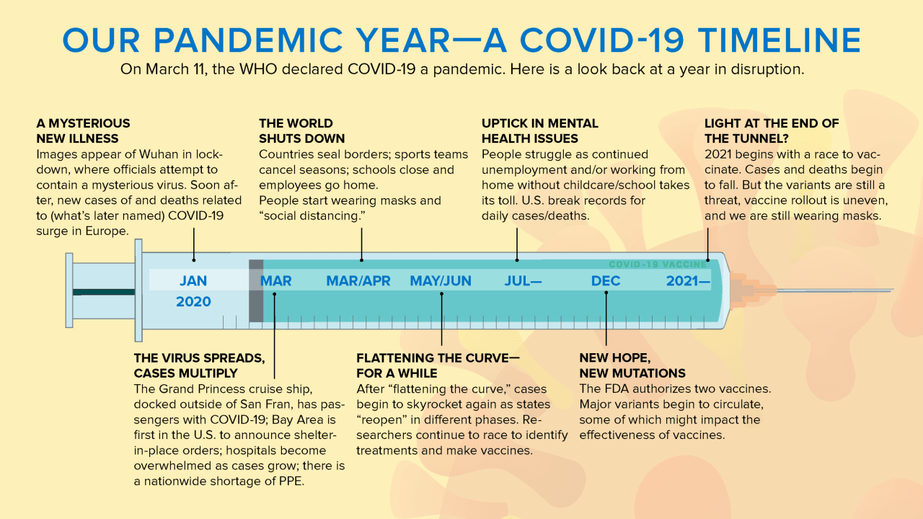
Motivation for our project
Question: Whether the factors presented in the COVID-19 dataset can provide a worthwhile analysis of the spread of the virus, and whether we can apply this to a machine learning model

Slide 4
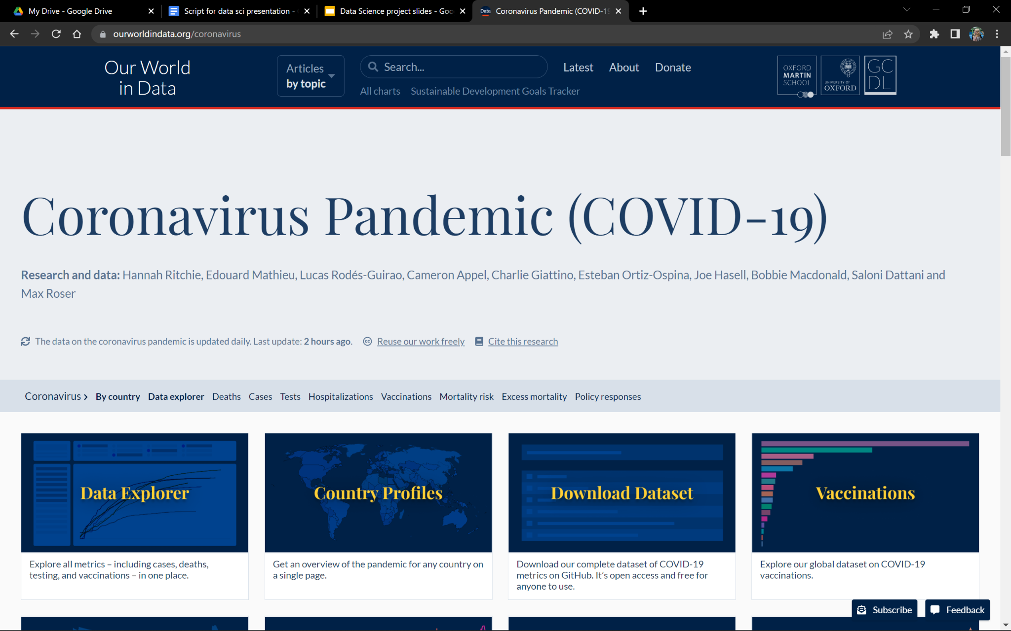
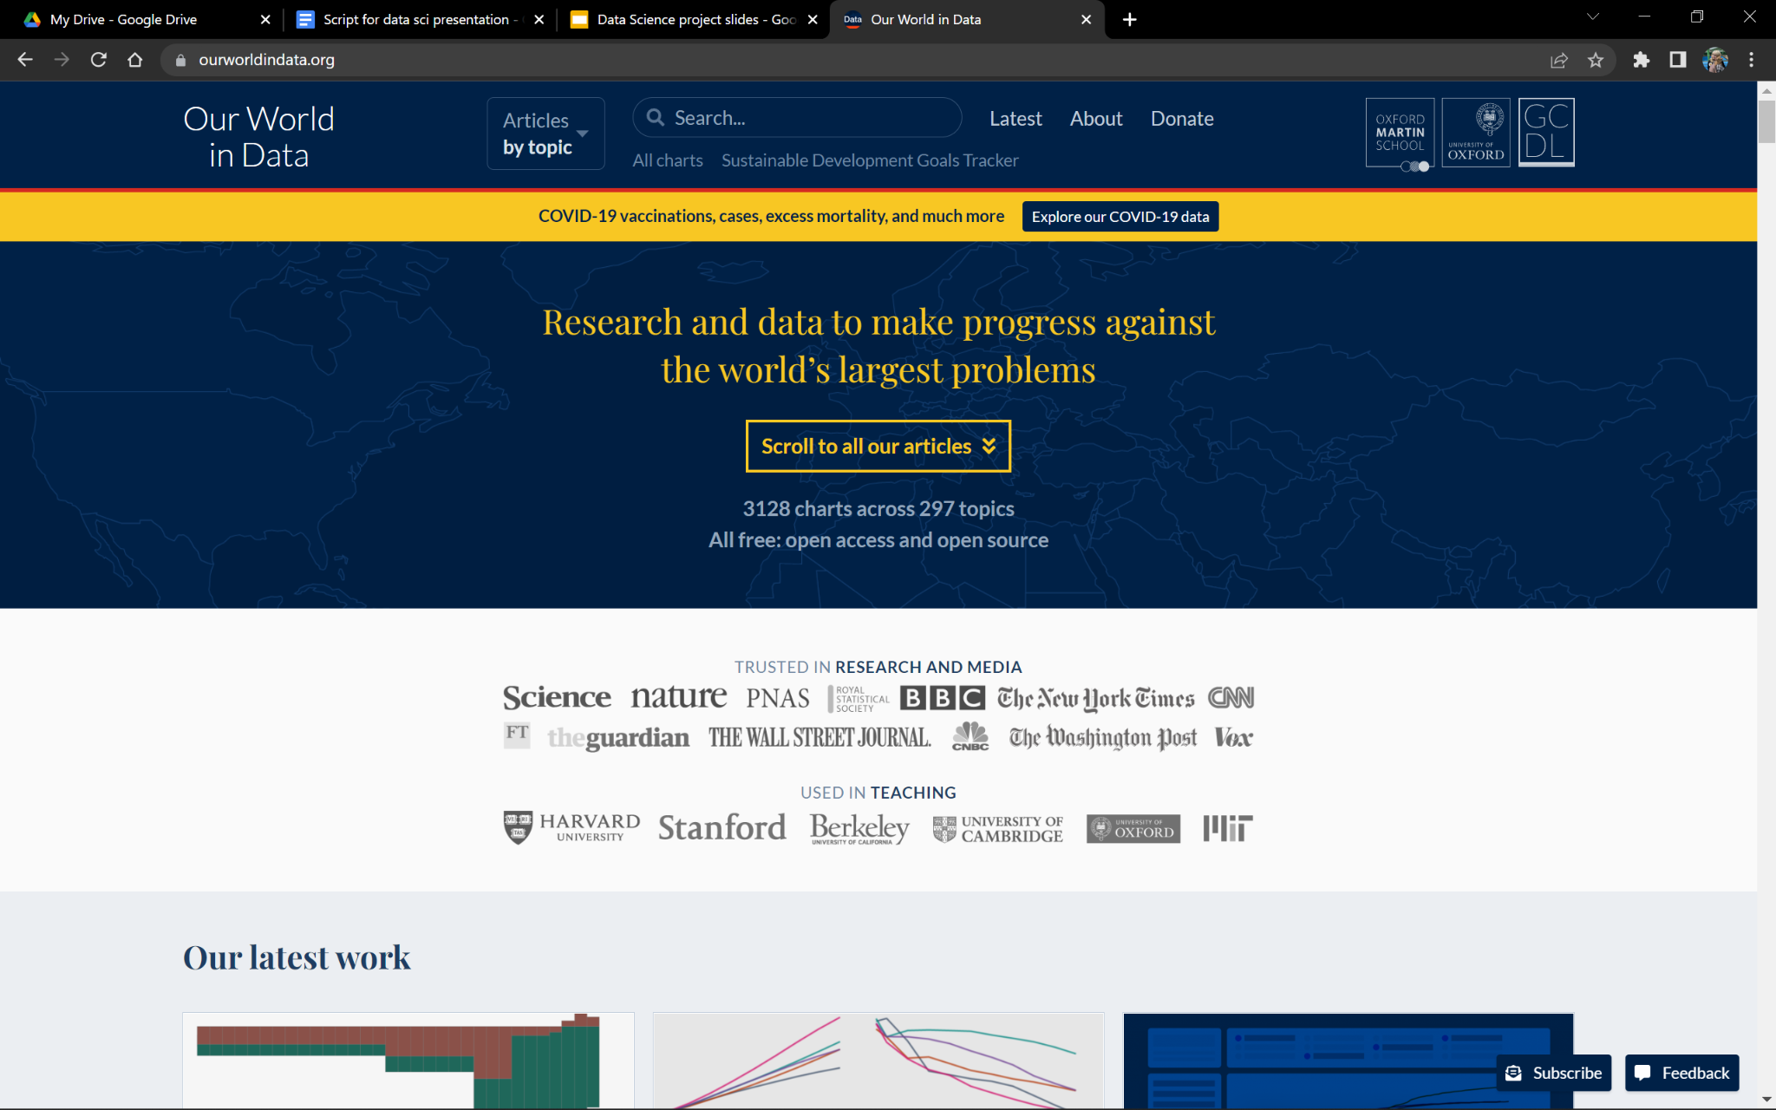
What we will be exploring
Death rate
Vaccination rates
Stringency index
Hospitalisation number

Slide 5
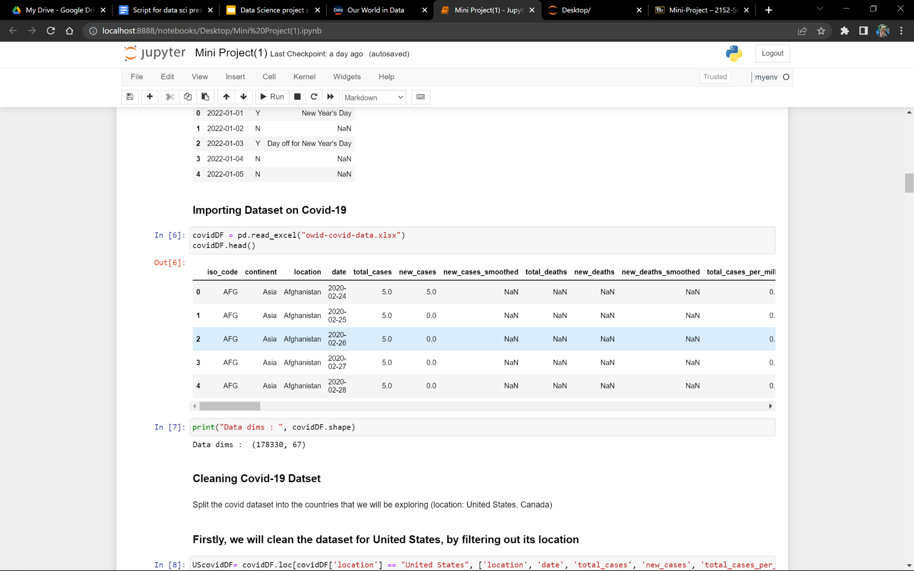
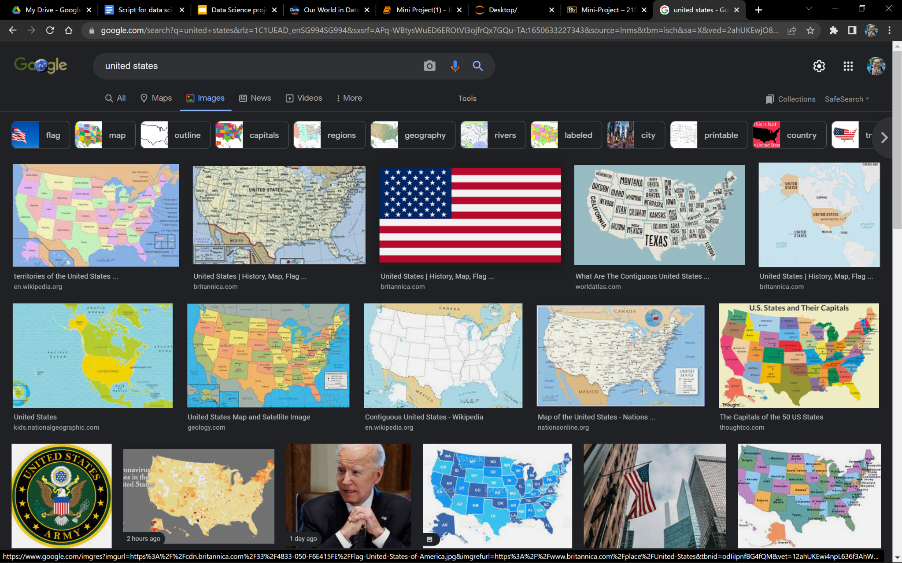
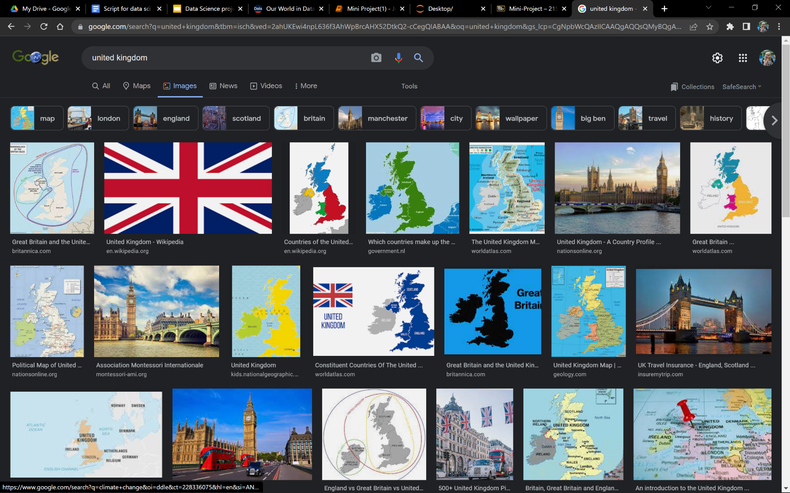
Cleaning our dataset
United states
Train dataset
Test dataset
United kingdom
Train dataset
Test dataset

Slide 6
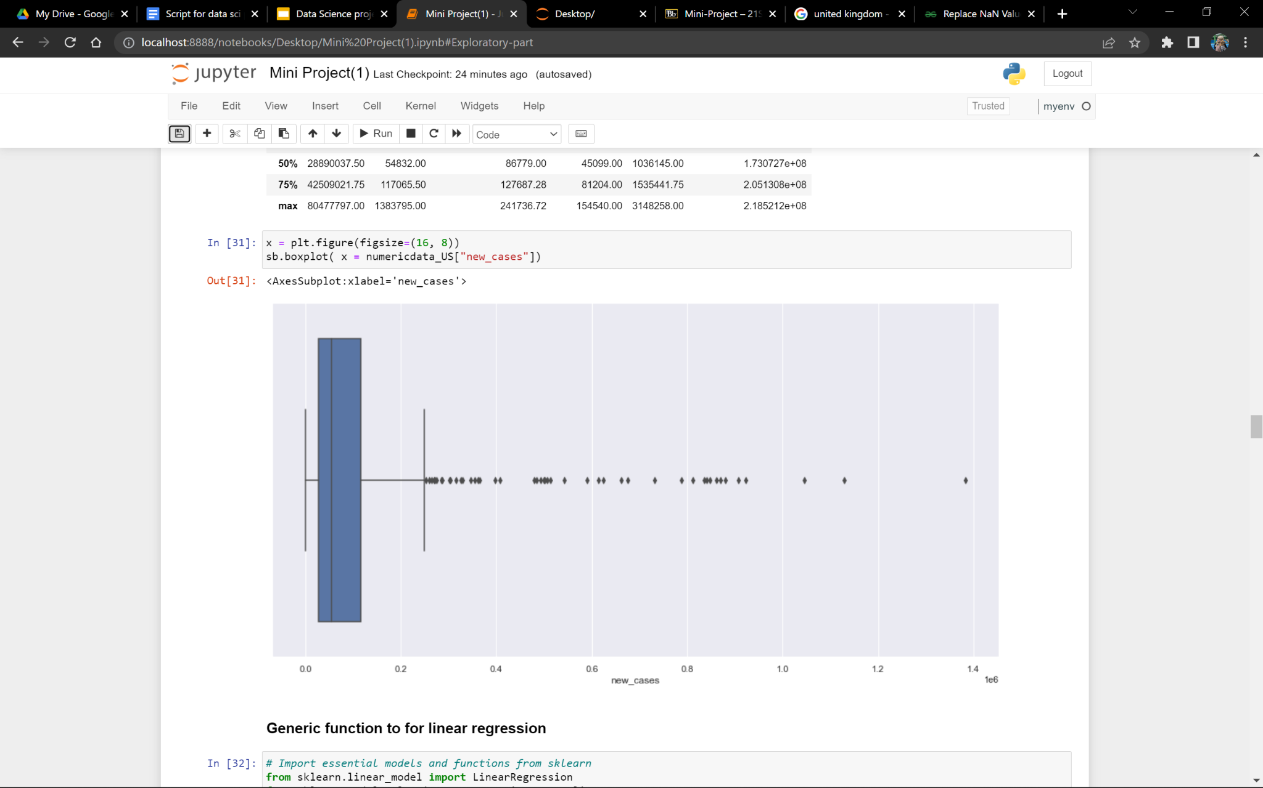
Number of covid cases daily in US
COVID-19 cases around 50k-100k cases daily
Several days of outliers with the highest recorded almost 1.4 million cases

Slide 7
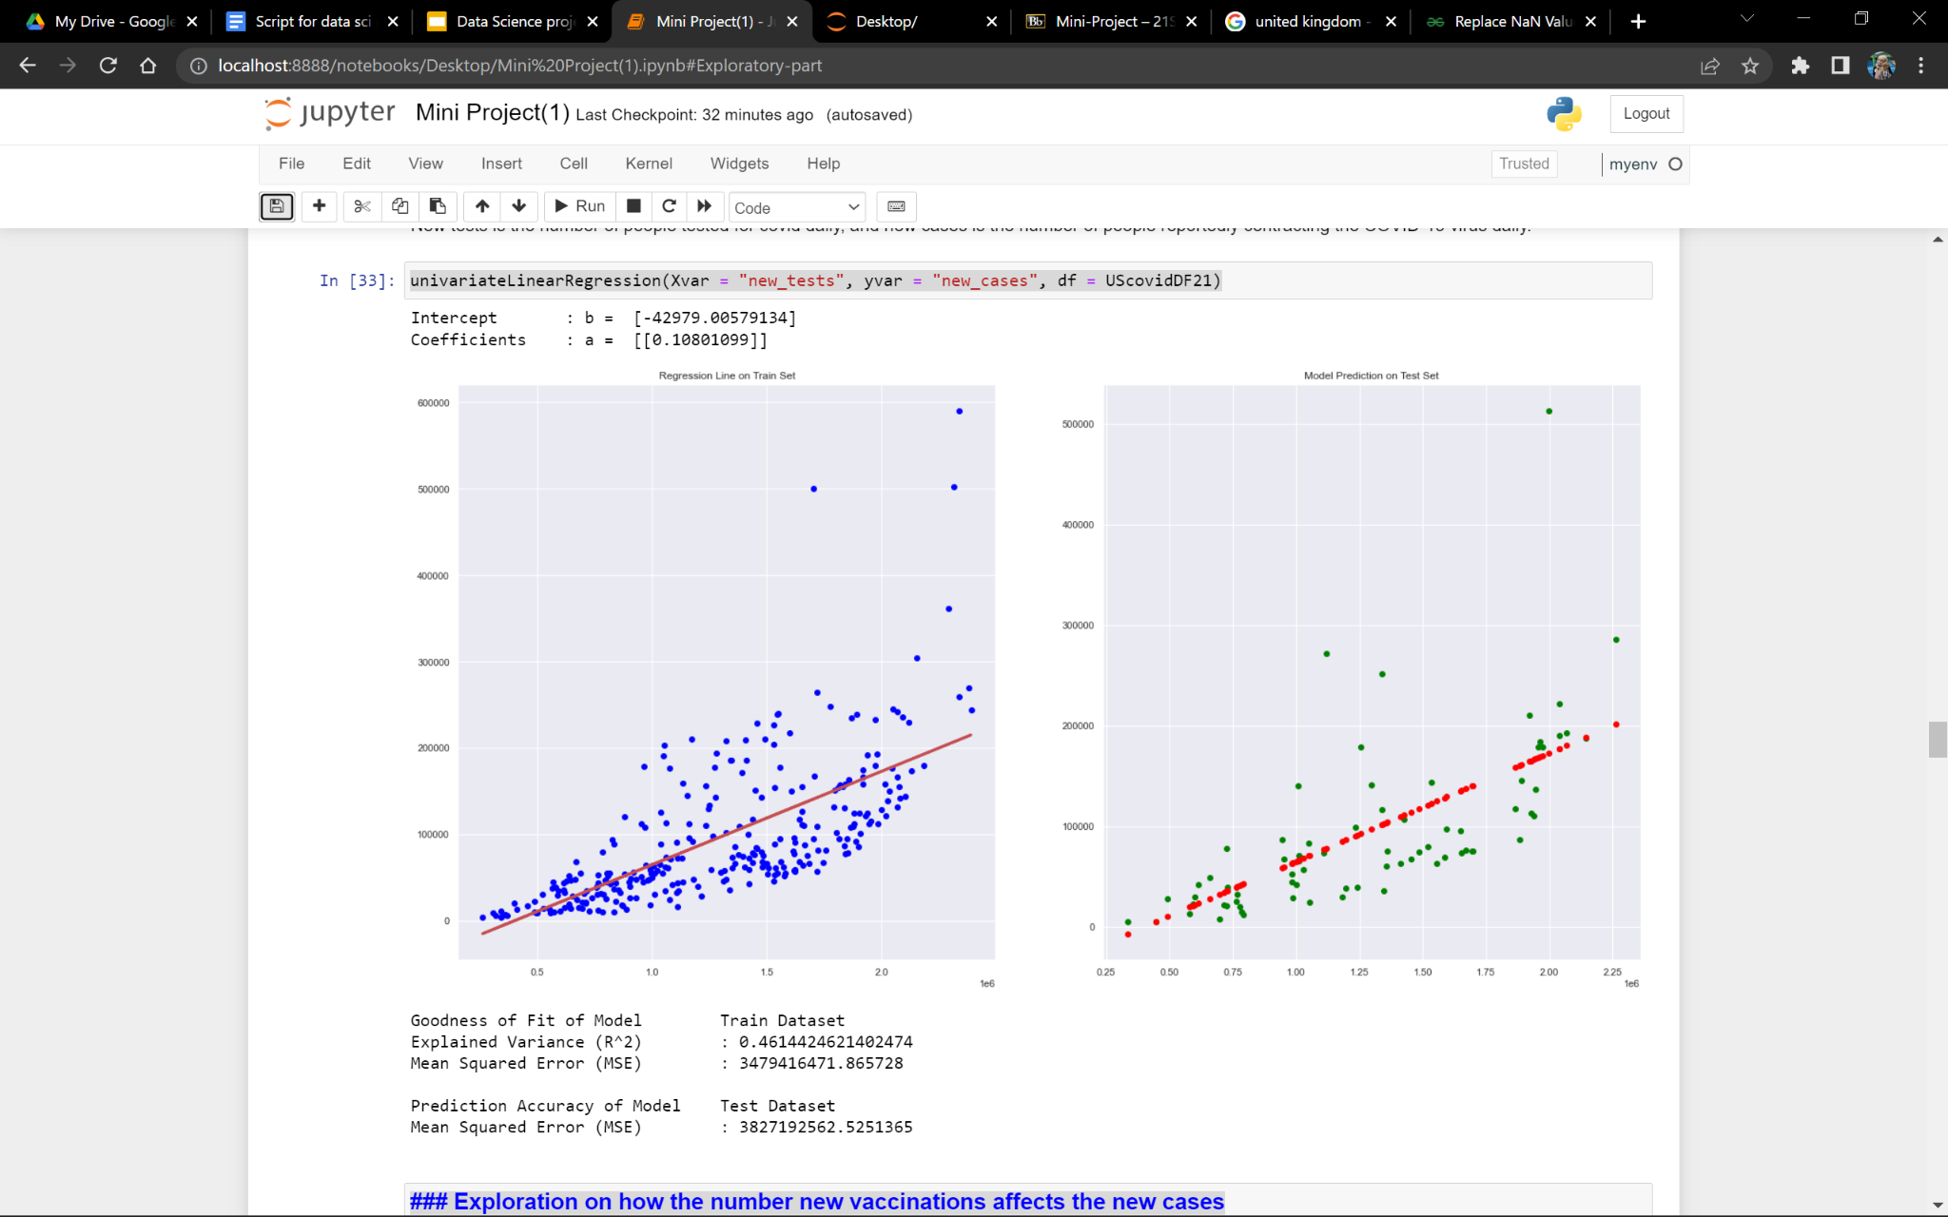
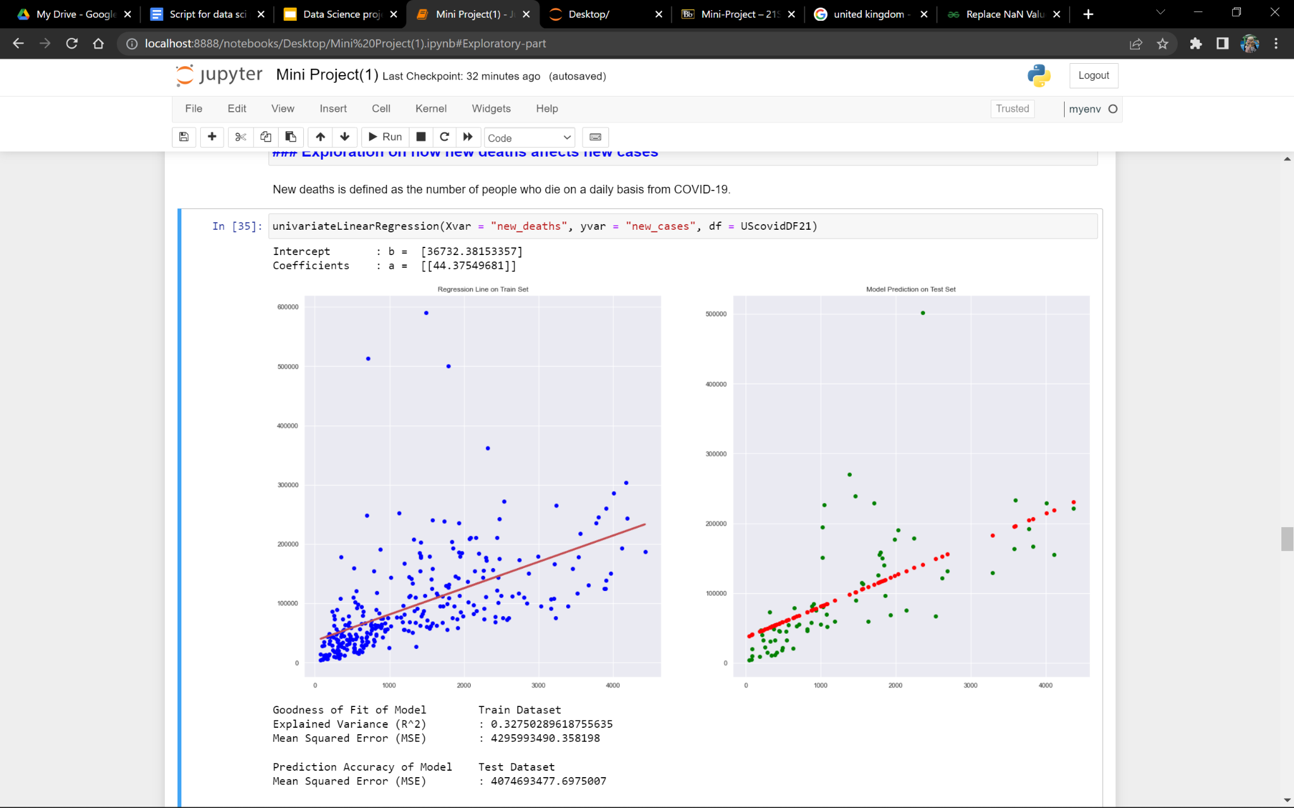
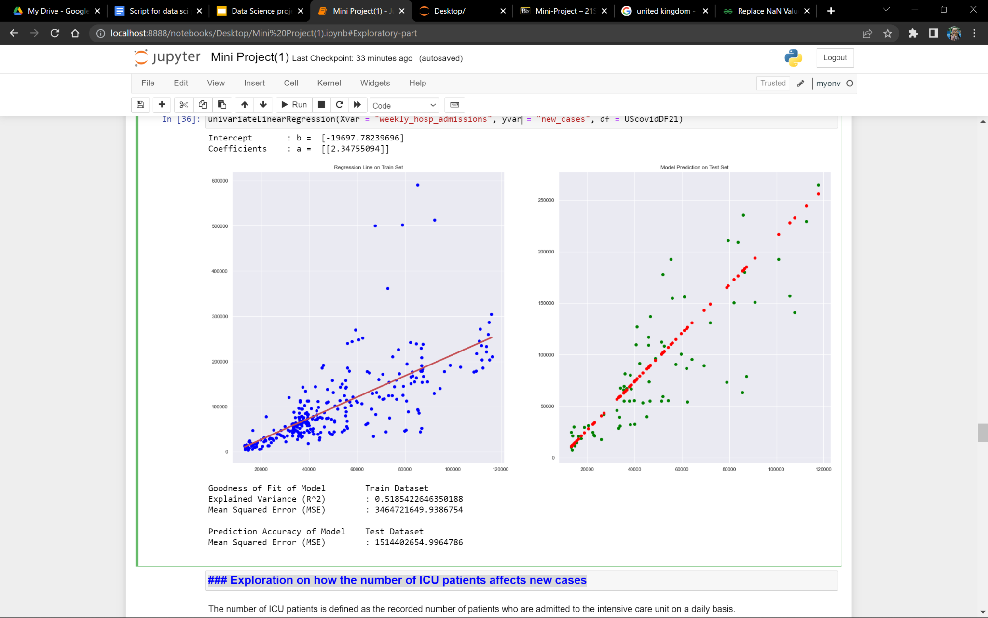
What we found out
New tests
Number of deaths
Hospital admissions

Slide 8
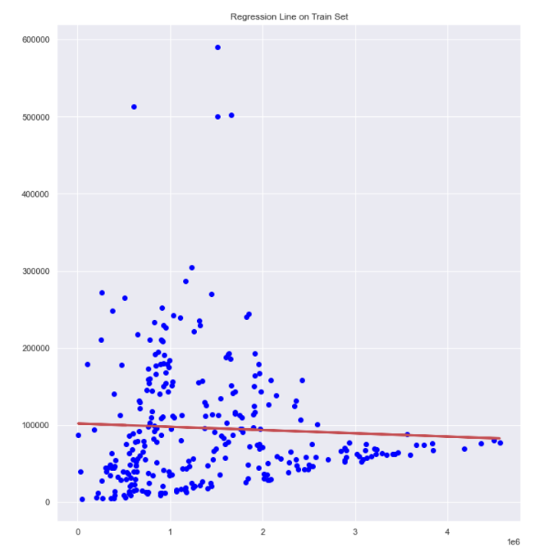
What we found out
Number of new vaccinations/vaccination rate
NO CLEAR RELATIONSHIP!

Slide 9
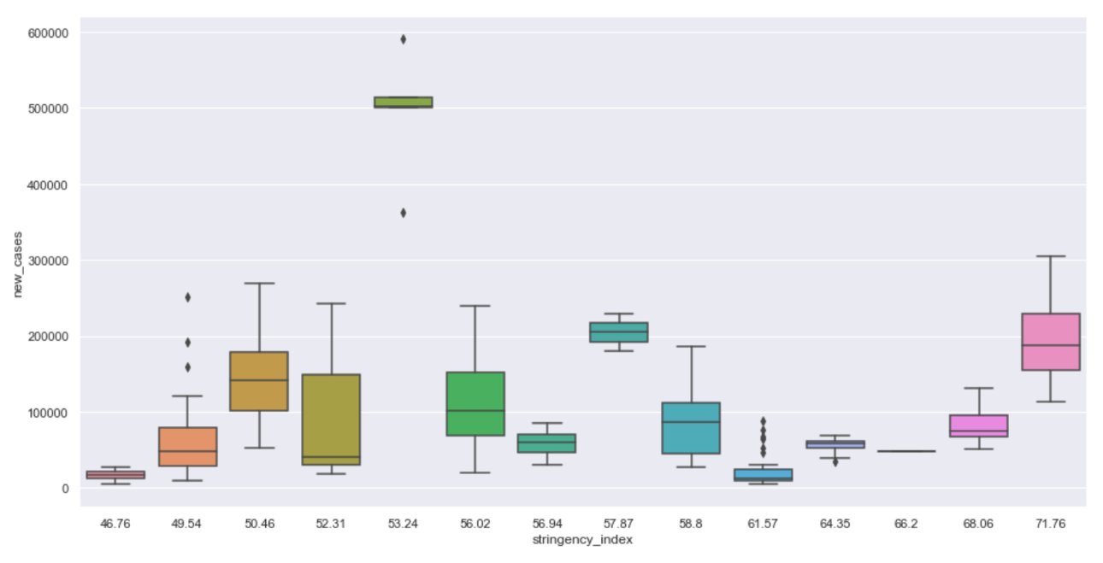
What we found out
Stringency index on the new cases daily
NO CLEAR RELATIONSHIP!

Slide 10
Conclusion from exploration
So, what can we do?
A lot of factors can affect the number of COVID-19 cases daily
Some factors are inconsistent
Hard to use such factors to predict future trends

Slide 11

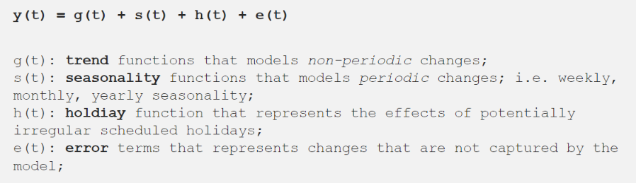
Machine learning model
Facebook Prophet
Can forecast a time series data
Can factor in holidays and handle outliers

Slide 12
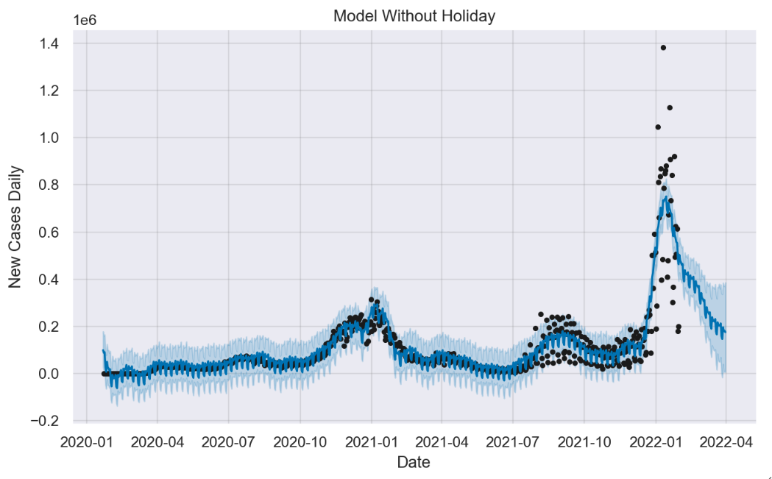
Prophet graph
First, we plotted a Prophet graph model using the new cases of our dataset
Prophet prediction of future cases
Train dataset (new_cases)
Legend:
Black dots- new_cases from dataset
Dark blue line-
Predicted data
Light blue region-
Uncertainty level of predicted data

Slide 13
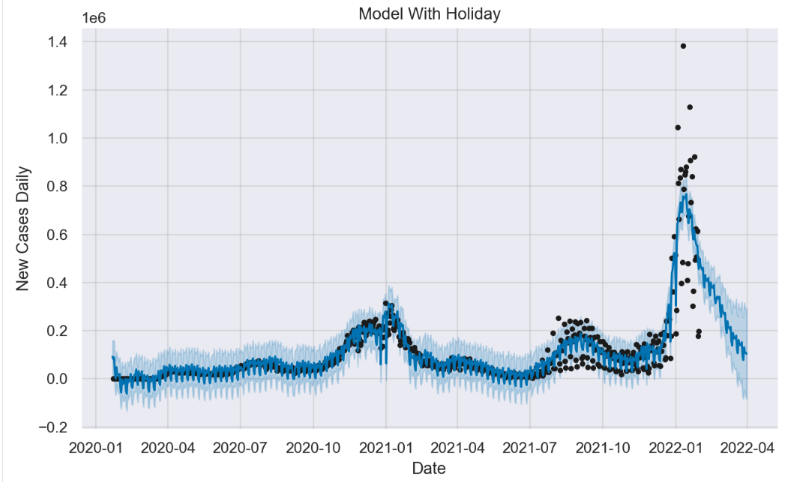
Prophet graph with holiday factor
Next, we factored in the holiday of US to help us plot a new graph
Prophet prediction of future cases
Train dataset (new_cases)
Number of predicted covid cases increases after christmas and new year’s holiday every year
From the graph ,we can tell that the holidays increases number of cases predicted, although it is not very significant

Slide 14
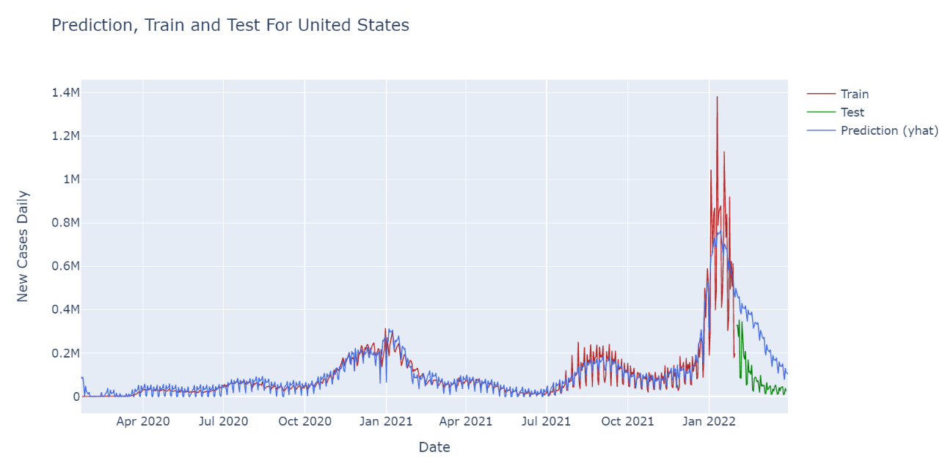
Prophet graph prediction analysis
Let us take a look at how the predicted results fair with the test cases
Prophet model predicted a downwards trend in the number of covid cases, just like the actual test cases as seen from the graph
Some limitations
In actual test case, COVID-19 cases dropped much faster than predicted data

Slide 15
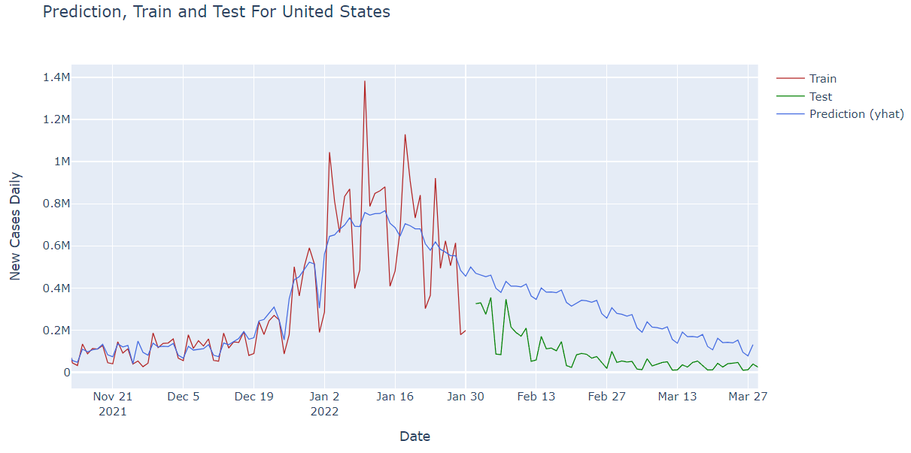
Prophet graph prediction analysis
Let us take a look at how the predicted results fair with the test cases
Prophet model predicted a downwards trend in the number of covid cases, just like the actual test cases as seen from the graph
Some limitations
In actual test case, COVID-19 cases dropped much faster than predicted data

Slide 16
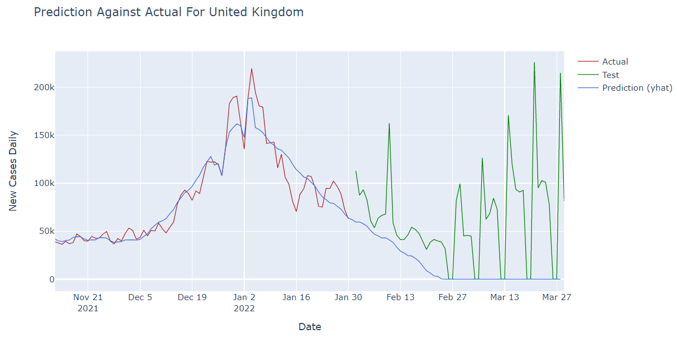
Prophet graph prediction analysis
Let us take a look at United Kingdom, and zoomed in
Similar downwards trend observed from prediction, but cases spiked on many occasions in the actual test data

Slide 17
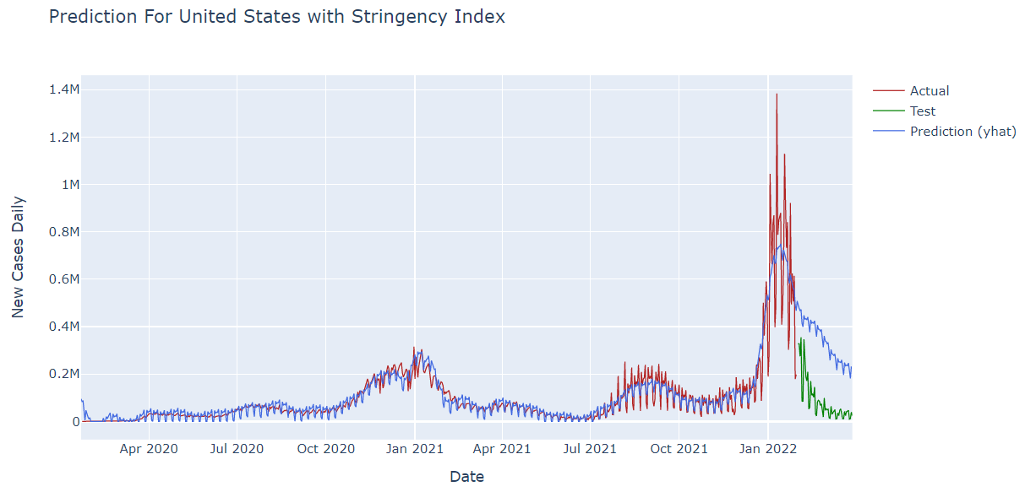
Prophet graph prediction analysis
Let us take a look at United States again but with stringency index
From the graph shown, there isn’t any visible change to the model when we tried adding the stringency index regressor

Slide 18
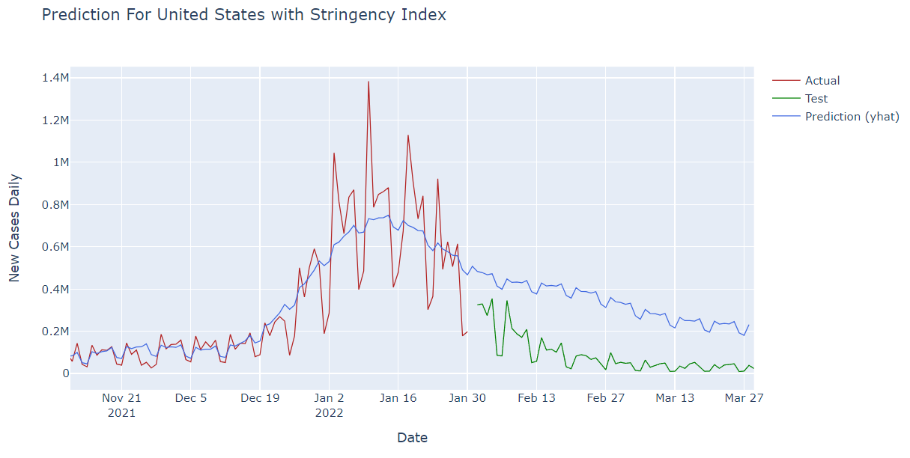
Prophet graph prediction analysis
Let us zoom in!
From the graph shown, there isn’t any visible change to the model when we tried adding the stringency index regressor

Slide 19
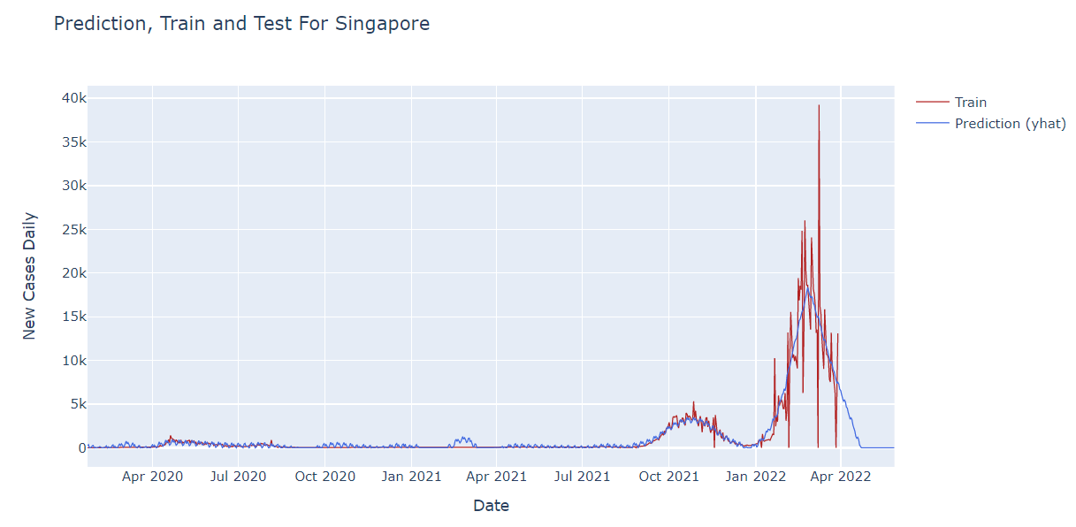
Prophet graph prediction analysis
Let us take a look at predicting 2 months of cases for Singapore
This time, we used 100% of the dataset on Singapore as the train data set, to predict 2 months worth of daily COVID-19 cases

Slide 20
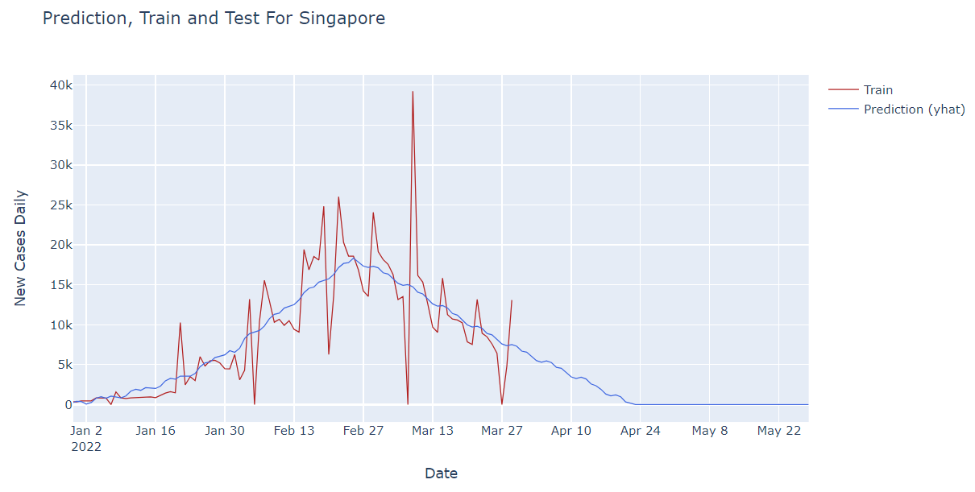
Prophet graph prediction analysis
Let us zoom in!
From the graph, we can tell that Prophet has predicted a decrease in the number of cases in the upcoming 2 months of Singapore

Slide 21
Conclusion from machine learning
Model is quite accurate in predicting cases will increase/decrease in the upcoming months
However, on some days number of cases might spike out of nowhere, and Prophet cannot foresee that
COVID regulation constantly changes

Slide 22
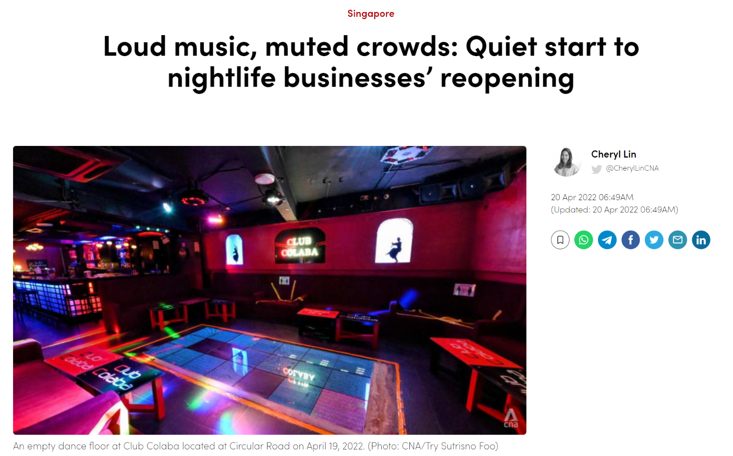
Conclusion from machine learning
Cases might vary from various regulations and relaxation of rules
Model must forecast a smaller number of days for it to be more accurate

Slide 23


